Slide 1

BANNARI AMMAN INSTITUTE OF TECHNOLOGY
S8 Project Work – Final review– (31.03.2023)
SIGN LANGUAGE DETECTION
External Own Project
Name: Mahibalan K
Reg. No:201CS504
Dept: CSE
Name: Madhan M
Reg. No:191CS209
Dept: CSE
Name: Roshan J
Reg. No:191ME202
Dept: ME
Guide details (EI10249)
Name: Mr R Dhanasekar
Designation: Assistant professor
Dept: EI

Slide 2
Abstract
Sign language is used by deaf and hard-of-hearing people, as well as those who are unable to speak vocally, to communicate within their groups and with others.
Using webcam photos, a dataset is created for the usual hand gestures used in a dataset for the identification of 36 different gestures of alphabets and numbers.
By developing algorithms using TensorFlow and OpenCV we can instantly predict the alphanumeric hand gestures used in sign language, this initiative aims to close the communication gap.
The major objective of this project is to develop an intelligent computer-based system that will enable deaf people to efficiently communicate with others by using hand gestures.

Slide 3
Introduction
Only a small number of people who are often connected with disabilities, such as families, activists, and instructors, are able to communicate using sign language. Natural gestures and official indications are the two main categories in sign language. The natural cue is a substitute for words that is used by a deaf person instead of body language. It is a manual expression that is agreed upon by the user.
The goal of this project, which is categorised under Human Computer Interface, is to detect several alphabets, numerals, and some common SL family hand gestures like "Thank you," "Hello," and other expressions.

Slide 4
Literature Survey
This work proposes a novel sign language identification method for identifying alphabets and gestures in sign language. People who are deaf use a form of visual sign language and gestures to communicate. In sign languages, meaning is communicated through the visual-manual modality. People who are Deaf or hard of hearing are the ones who use it the most.
The downside of this approach is that you must constantly wear more clothing, and the findings are less precise. Computer-vision-based techniques, on the other hand, use only a camera and allow for natural contact between humans and computers without the use of any extra technologies.

Slide 5
Methodology
Gathering the necessary datasets helps greatly in achieving high accuracy for our model, after data collection preprocess them and train these datasets to prepare model out of it for evaluation with which we will be detecting the real world signs.
With the Help of tensor flow and OpenCV we are able to train the dataset and prepare a model for evaluating in real time. When any hand signs come into picture then that is captured and evaluated against the prepared model and if it matches with any signs then from the dataset the relevant word is displayed as text as well as audio command.

Slide 6
Flow Chart
Dataset
Train
Modal
Live Cam
Evaluation
Yes
Output
No
Nothing
Text
Audio

Slide 7
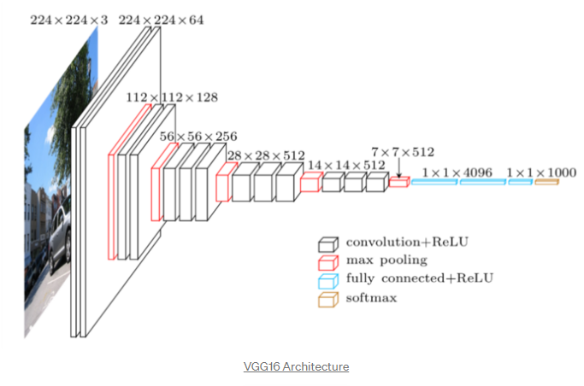
Algorithm Architecture

Slide 8
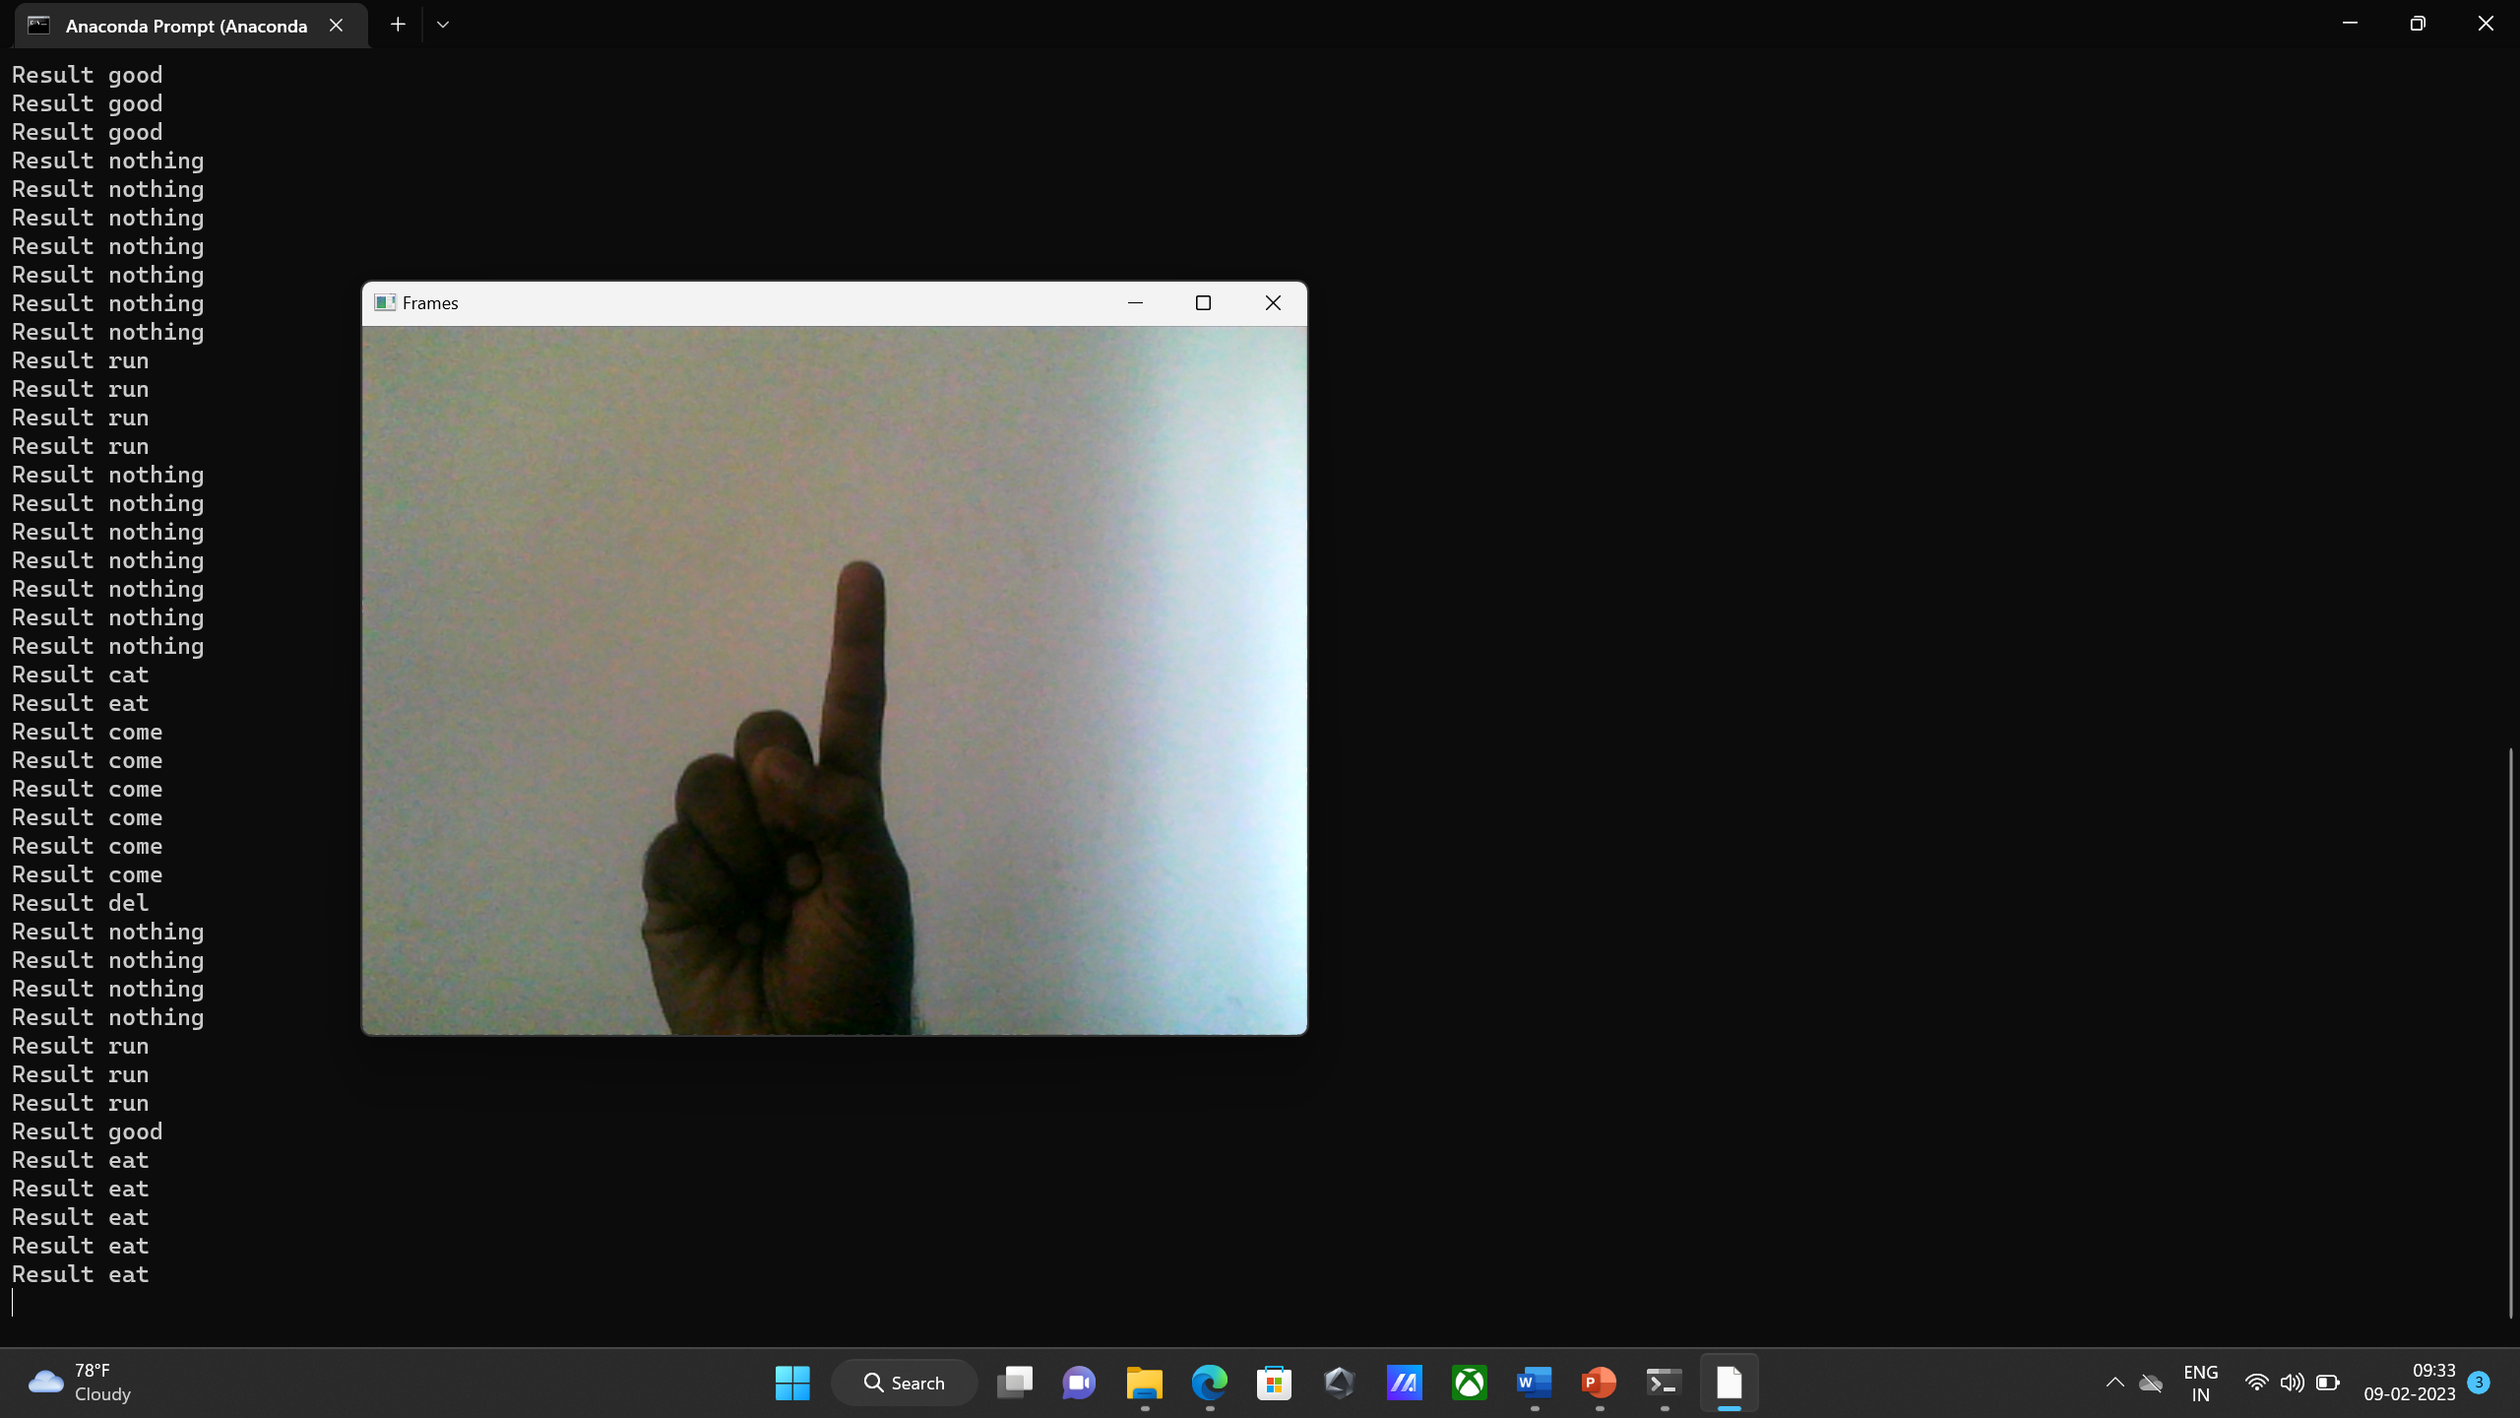
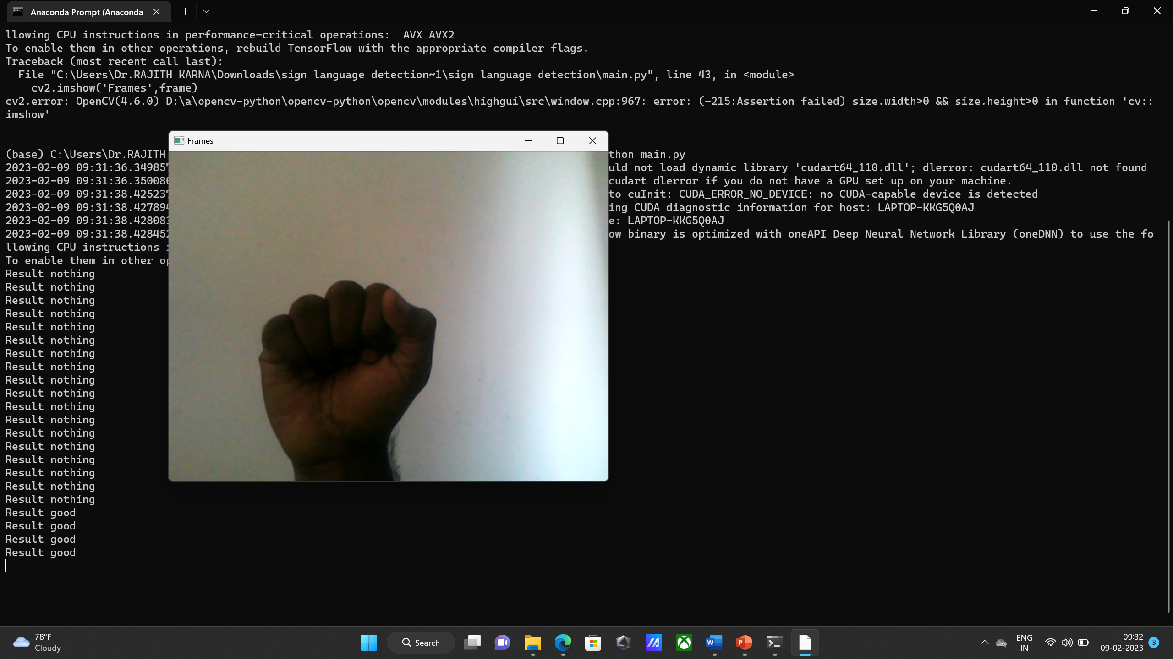
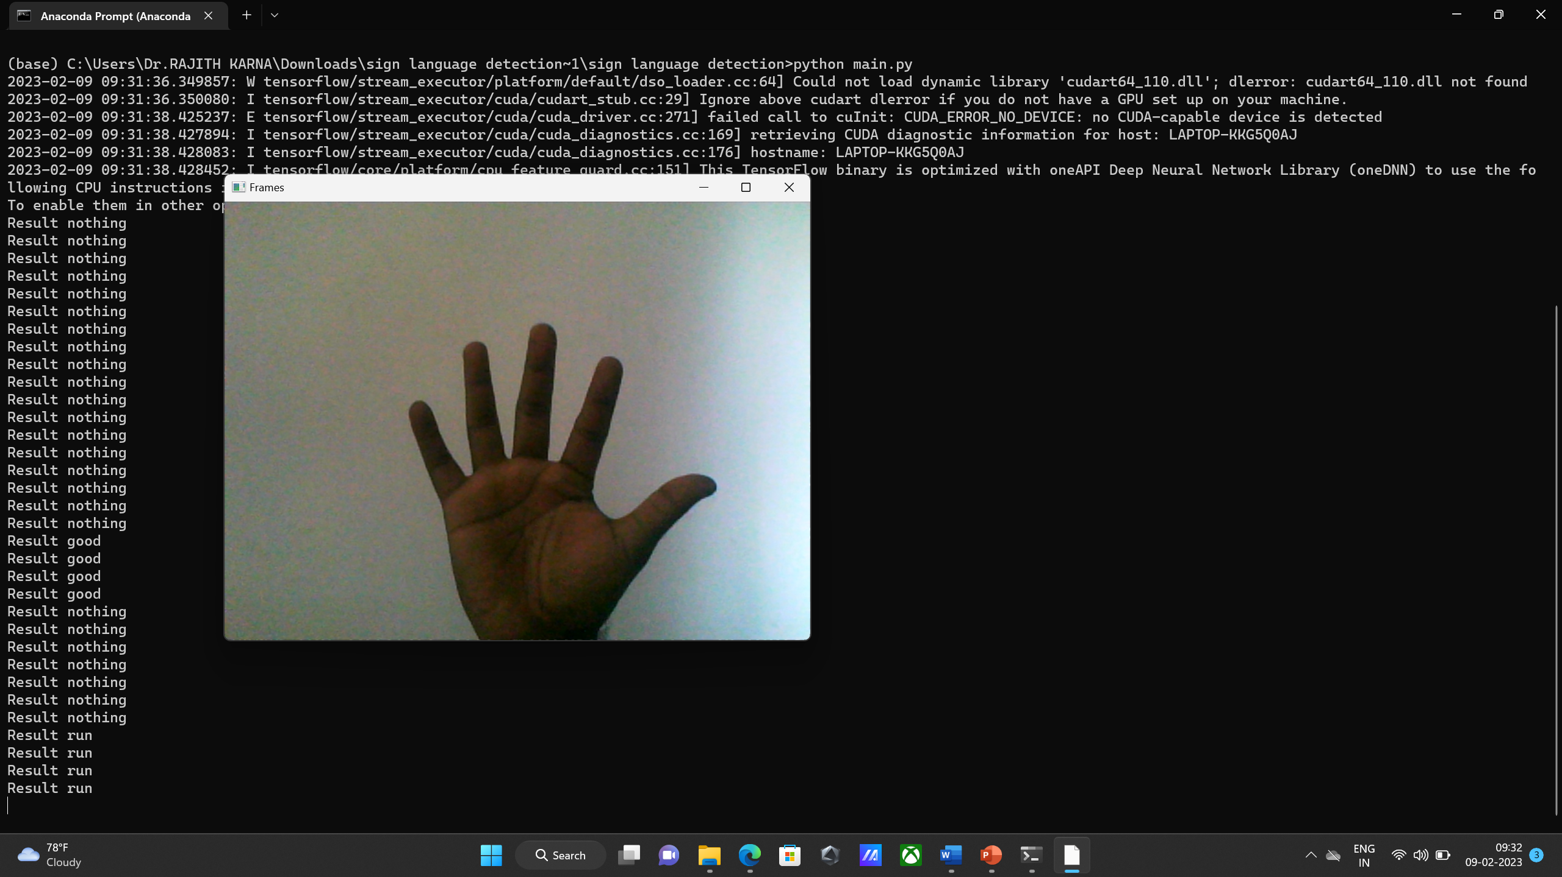
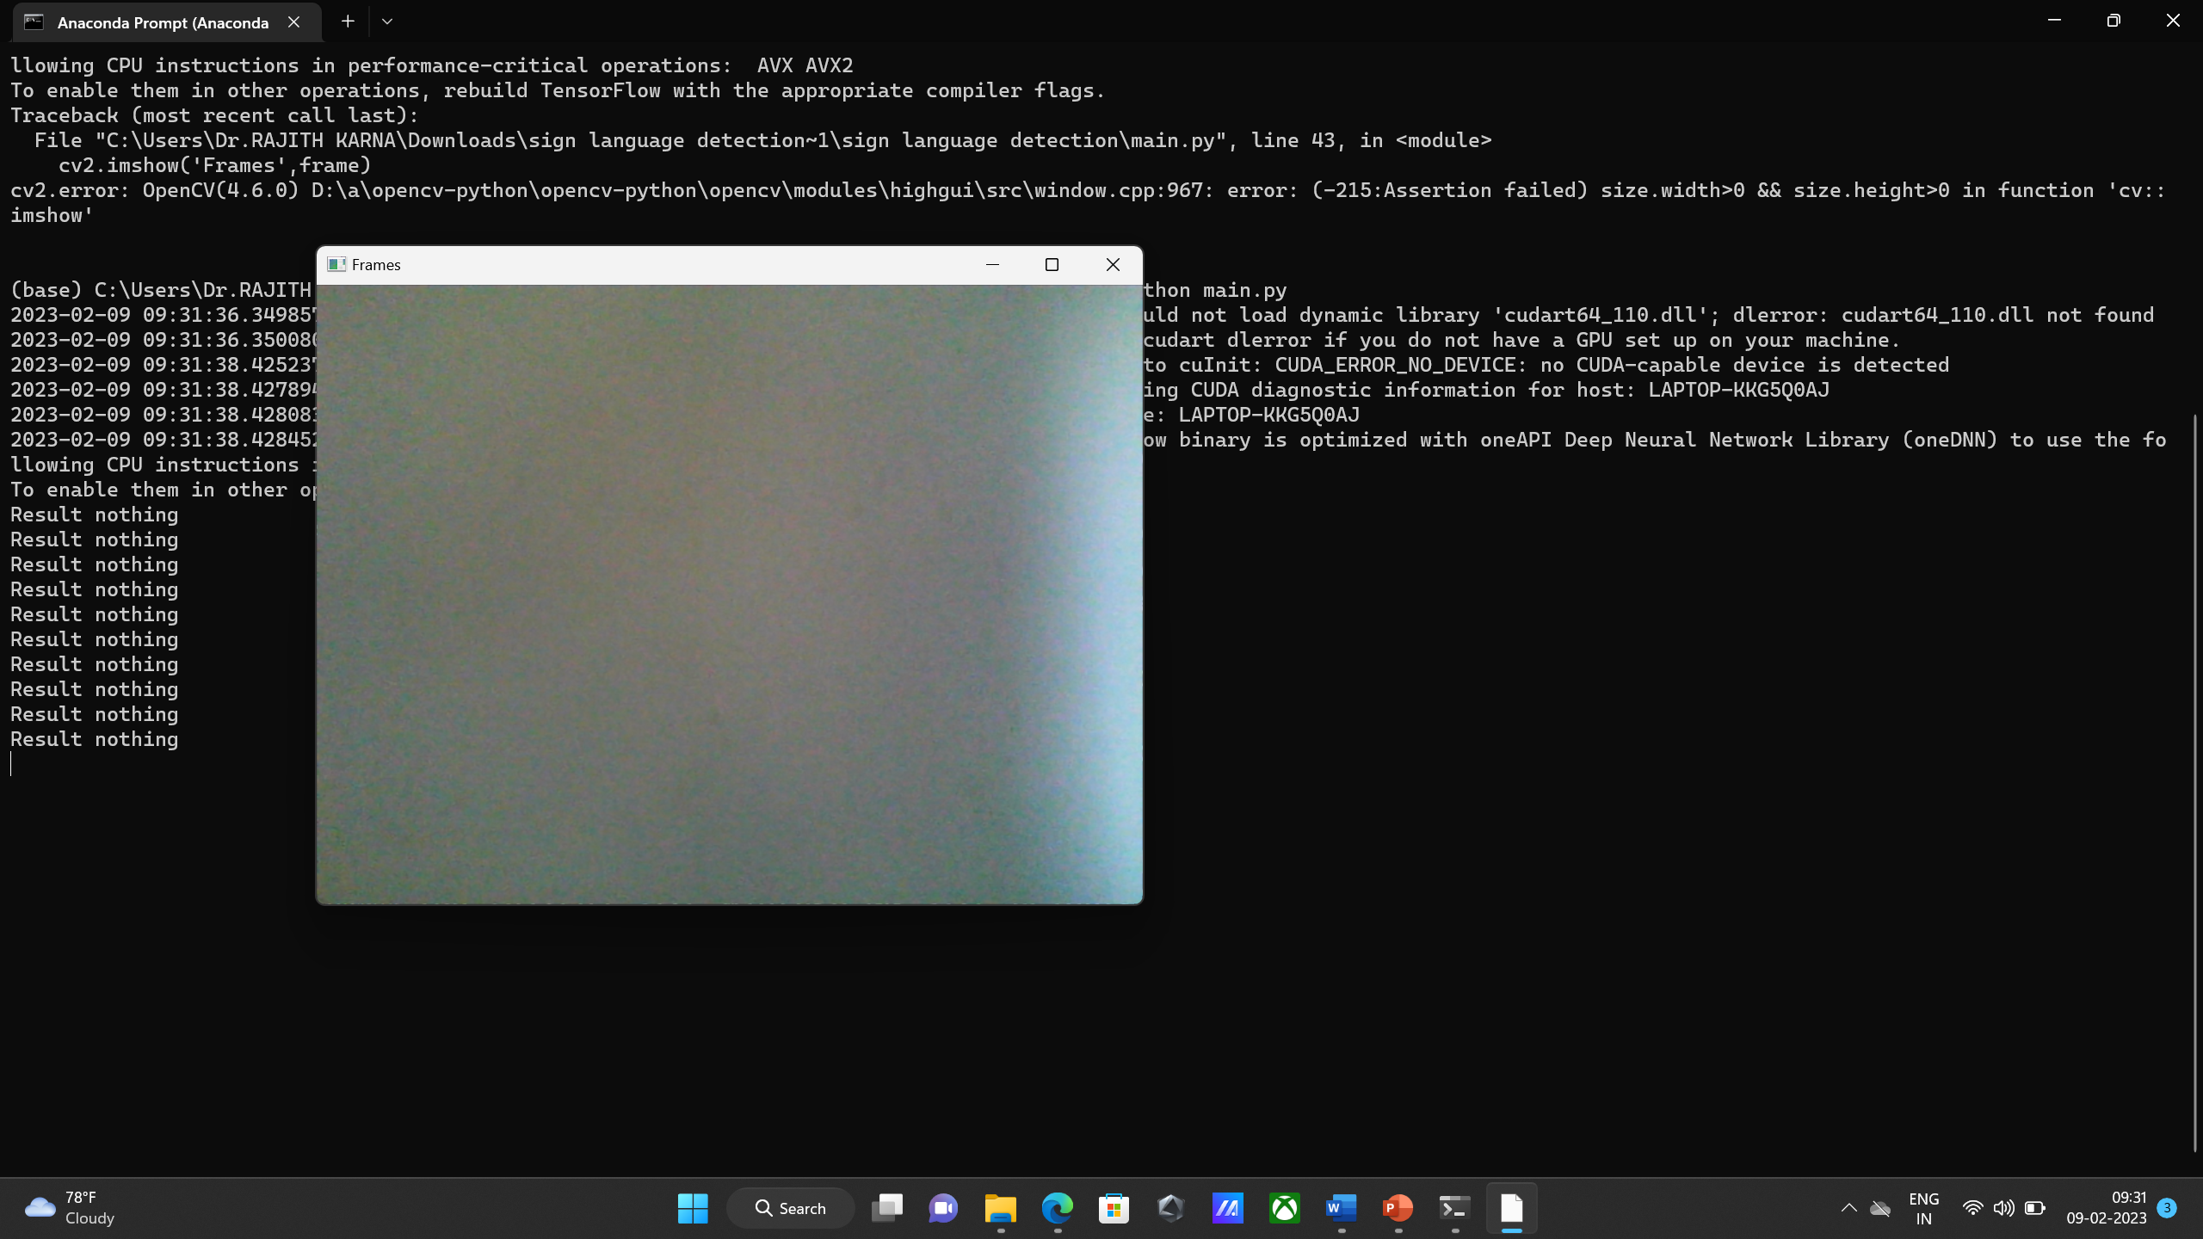
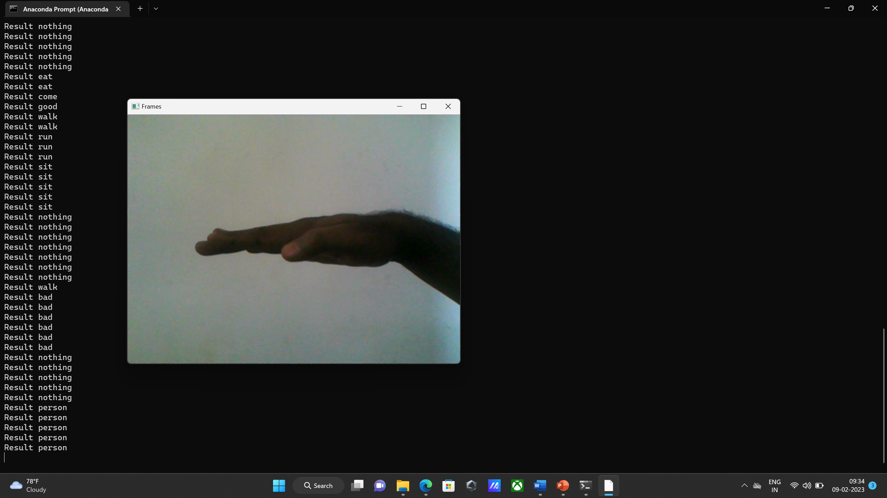
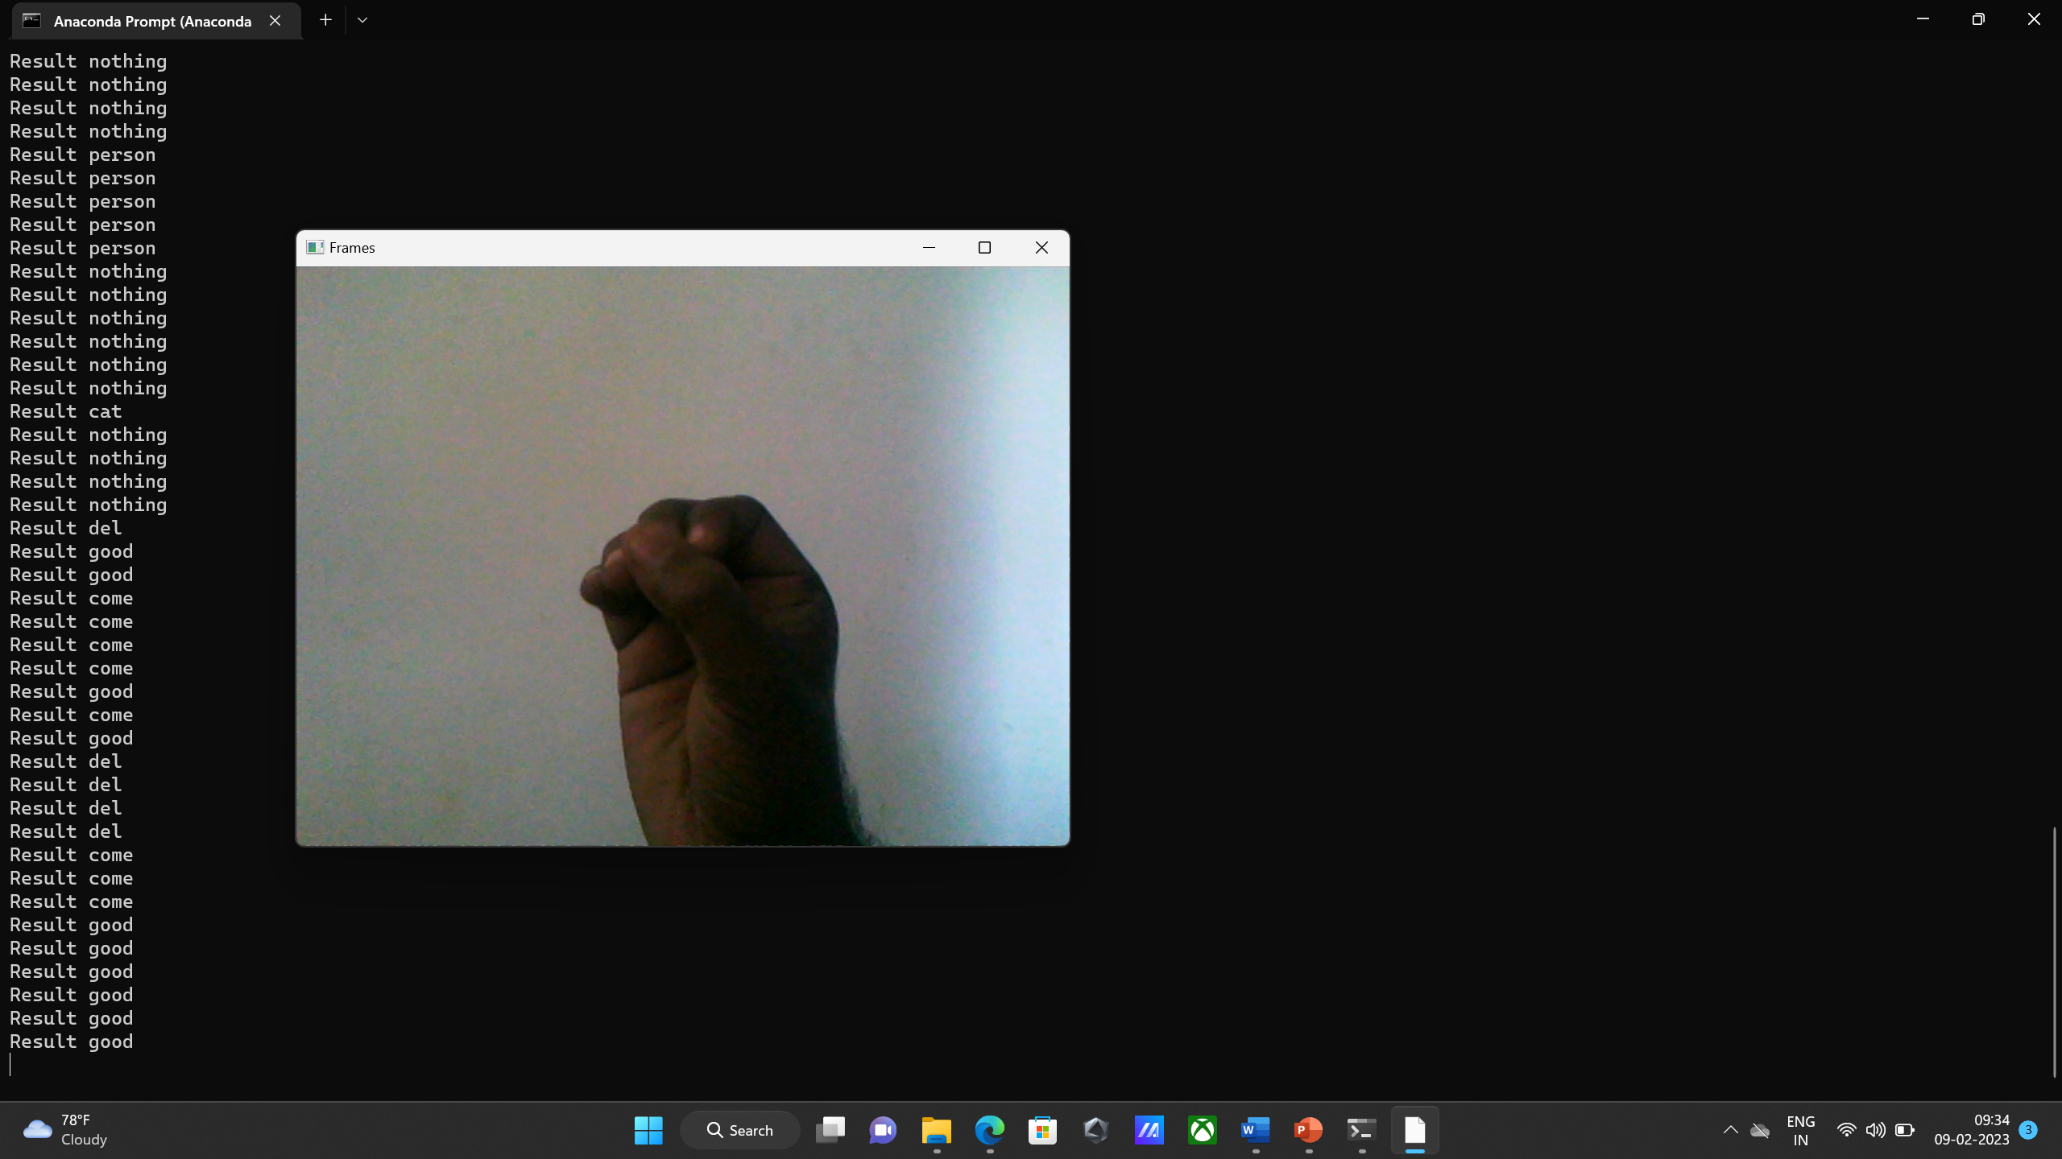
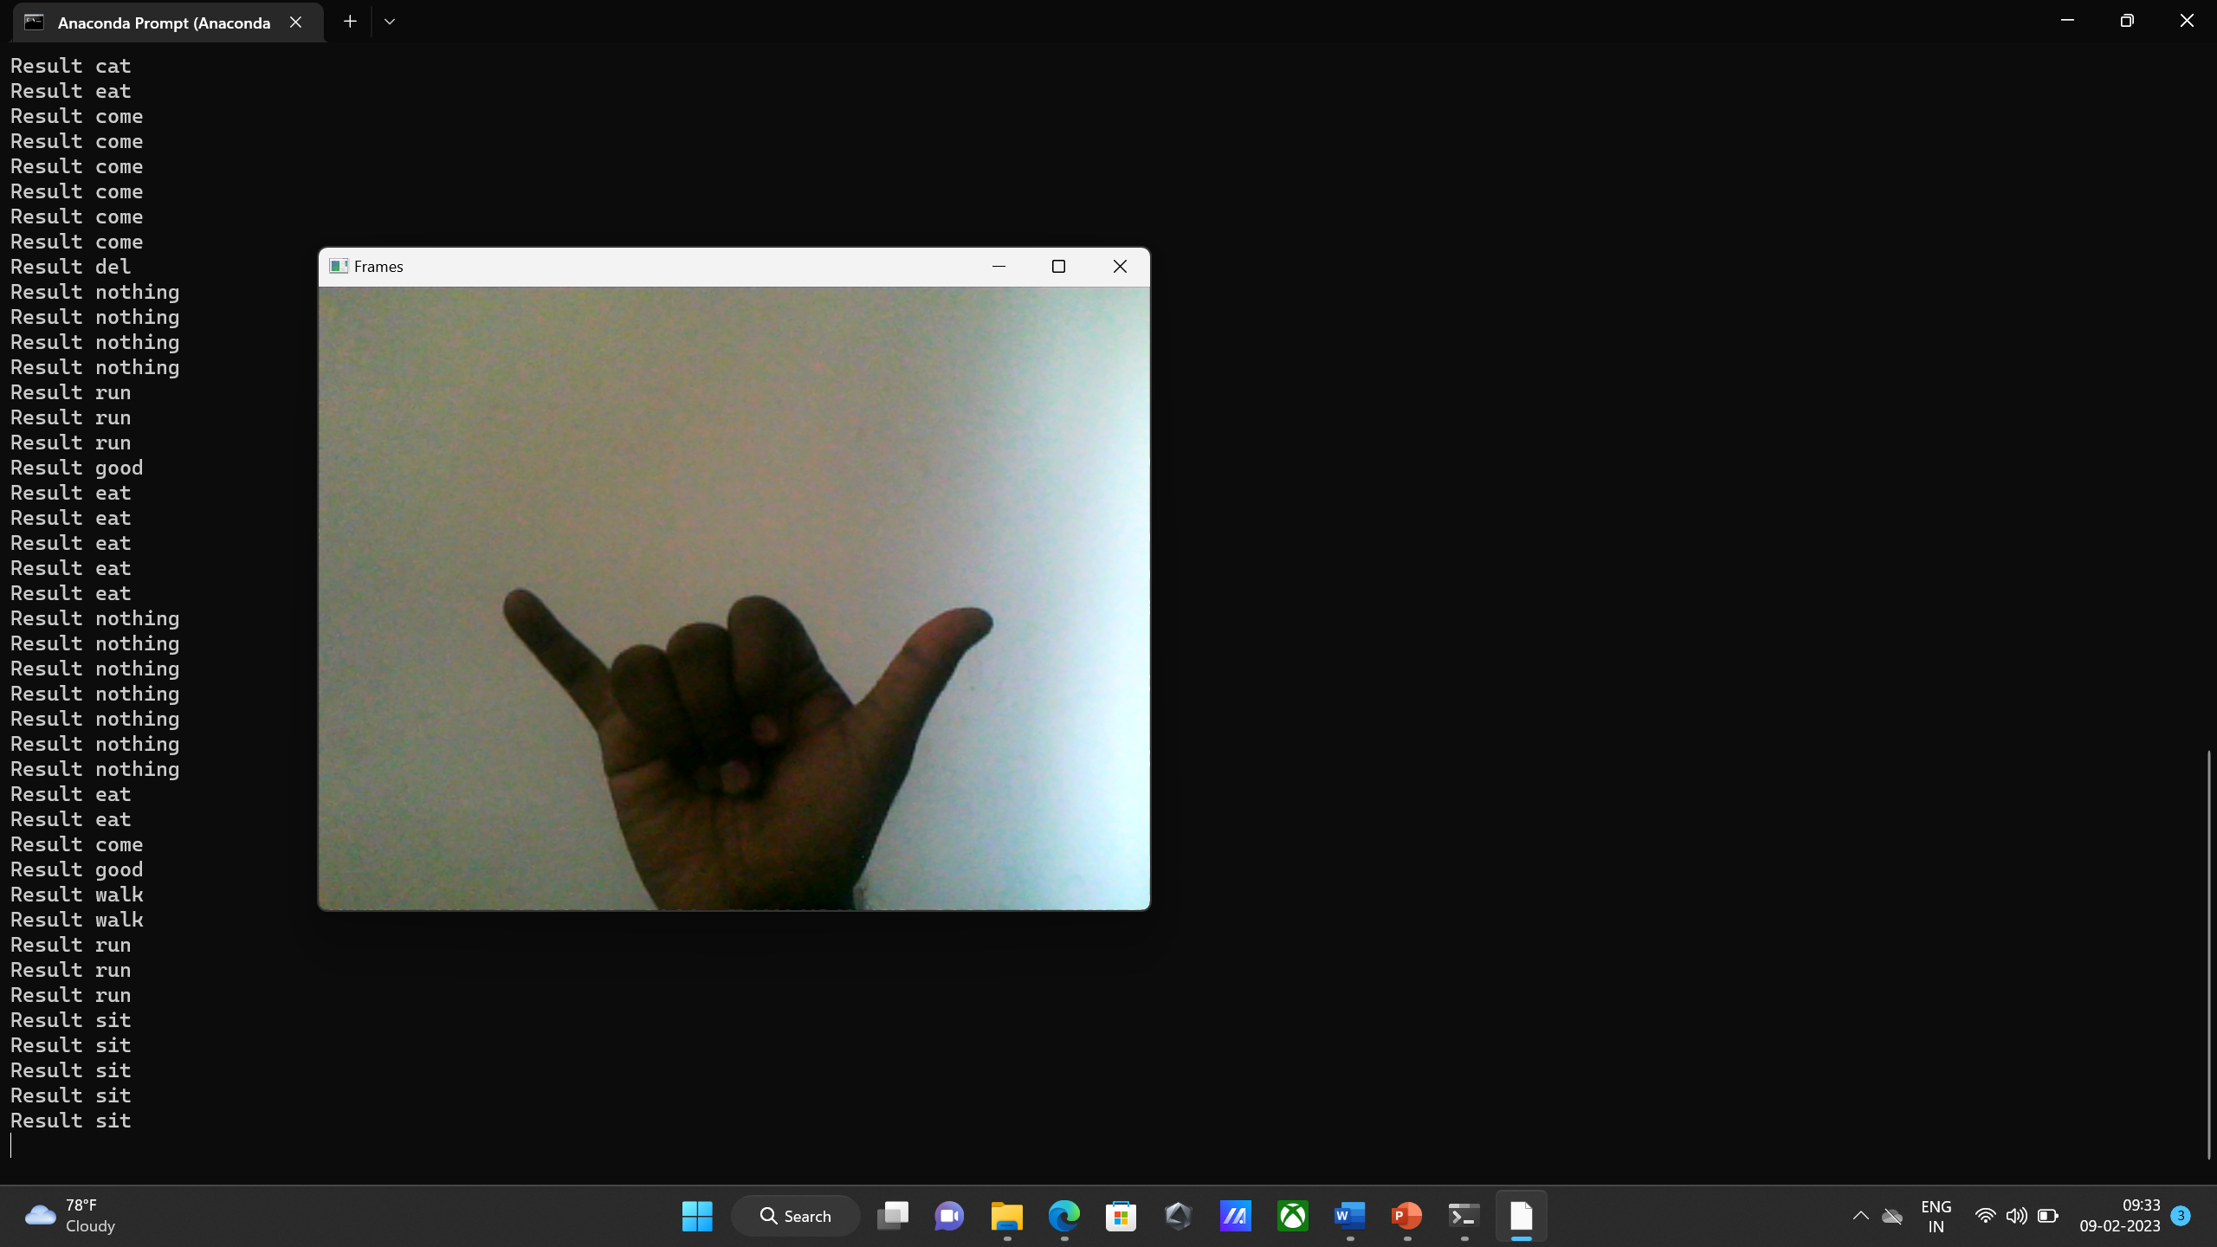
Results

Slide 9
System description
Effective Utilization of the modern tool:
SOFTWARE SPECIFICATION:
Operating System: Windows 10
Platform: Anaconda Prompt/Python 3.9
Coding Language: Python

Slide 10
Conclusion
The results of the model allow us to infer that the proposed system can deliver accurate results when surrounding light and intensity are controlled. Additional motions may readily be added, and the model will be more accurate thanks to more photographs taken at different angles and in different frames. The model may therefore readily be built up to a huge extent by increasing the size of the dataset.
The implementation of our model for other sign languages such as Indian sign language or American sign language. Further training with large dataset to efficiently recognize symbols. Improving the model's ability to identify expression

Slide 11
Reference
[1] Jamie Berke, James Lacy March 01, 2021 “Hearing loss/deafness| Sign Language”.
[2] “National Health Mission -report of deaf people in India”, nhm.gov.in 21-12-2021.
[3] Smith M and Levack N 1996 Teaching Students with Visual and Multiple Impairments: A Resource Guide (Texas : Texas School for the Blind and Visually Impaired)
[4] Stephanie Thurrott|November 22 ,2021 “The Best Ways to Communicate with Someone Who Doesn’t Hear Well”
[5] Williams P and Evans M 2013 Social Work with People with Learning Difficulties

Slide 12
Project work plan
WEEK | WORK PLAN
WEEK 1 | Selection of Domain and Project Title(via Literature Surveys)
WEEK 2 | Study the Basics related to Selected Domain, Aim & Objectives of the project, and an insight view of the project.
WEEK 3 | Literature review and Problem formulation in the identified Project and discussion the same with supervisor.
WEEK 4 | Idea / Algorithm / Hardware Architecture / Implementation strategy analysis.
WEEK 5 | Theoretical and Mathematical analysis.
WEEK 6 | Proposed Algorithm / Architecture in Hardware or Software - (step by step).
WEEK 7 | Incorporate / Modify the project work based on suggestions given by the project assessors along with supervisor.

Slide 13
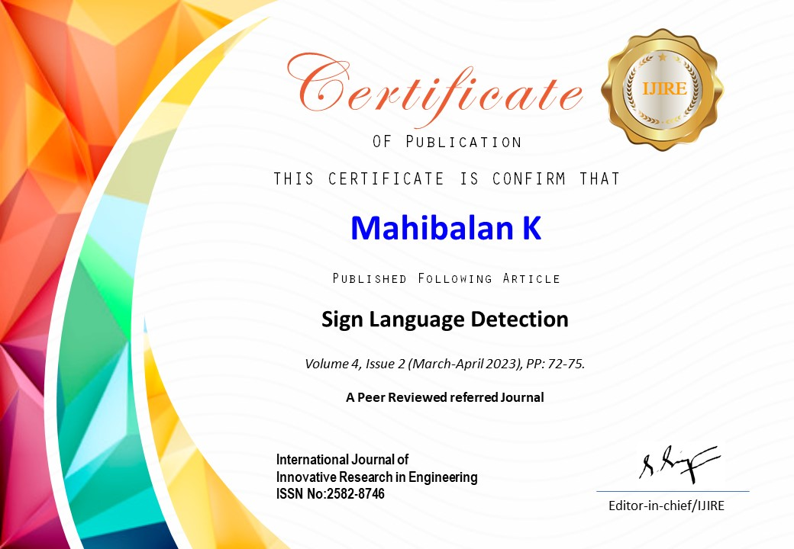
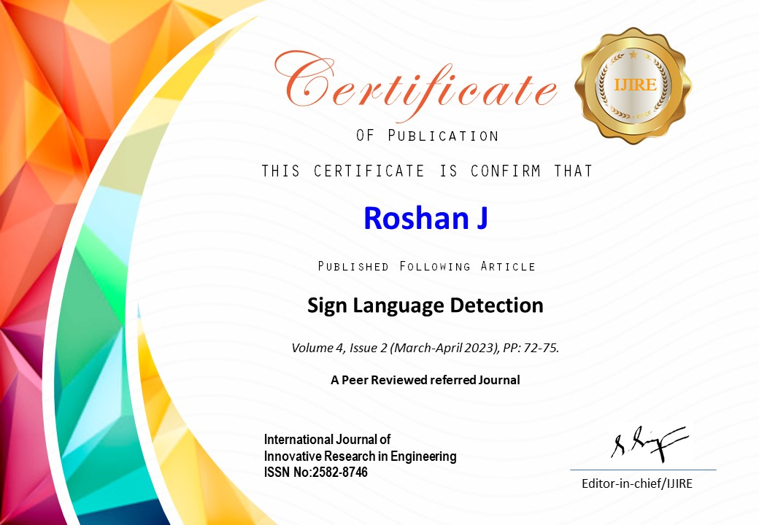
Certificate

Slide 14

Certificate

Slide 15
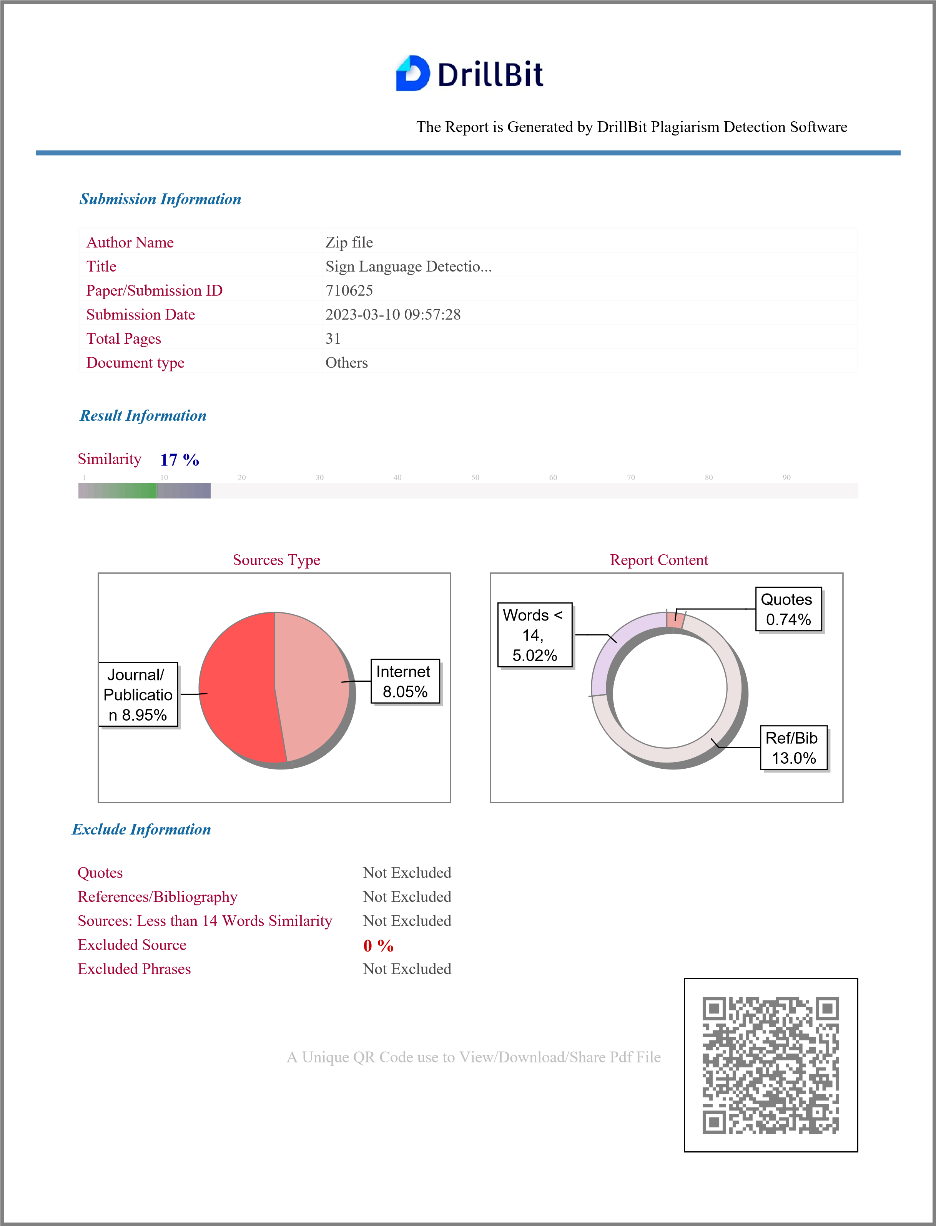
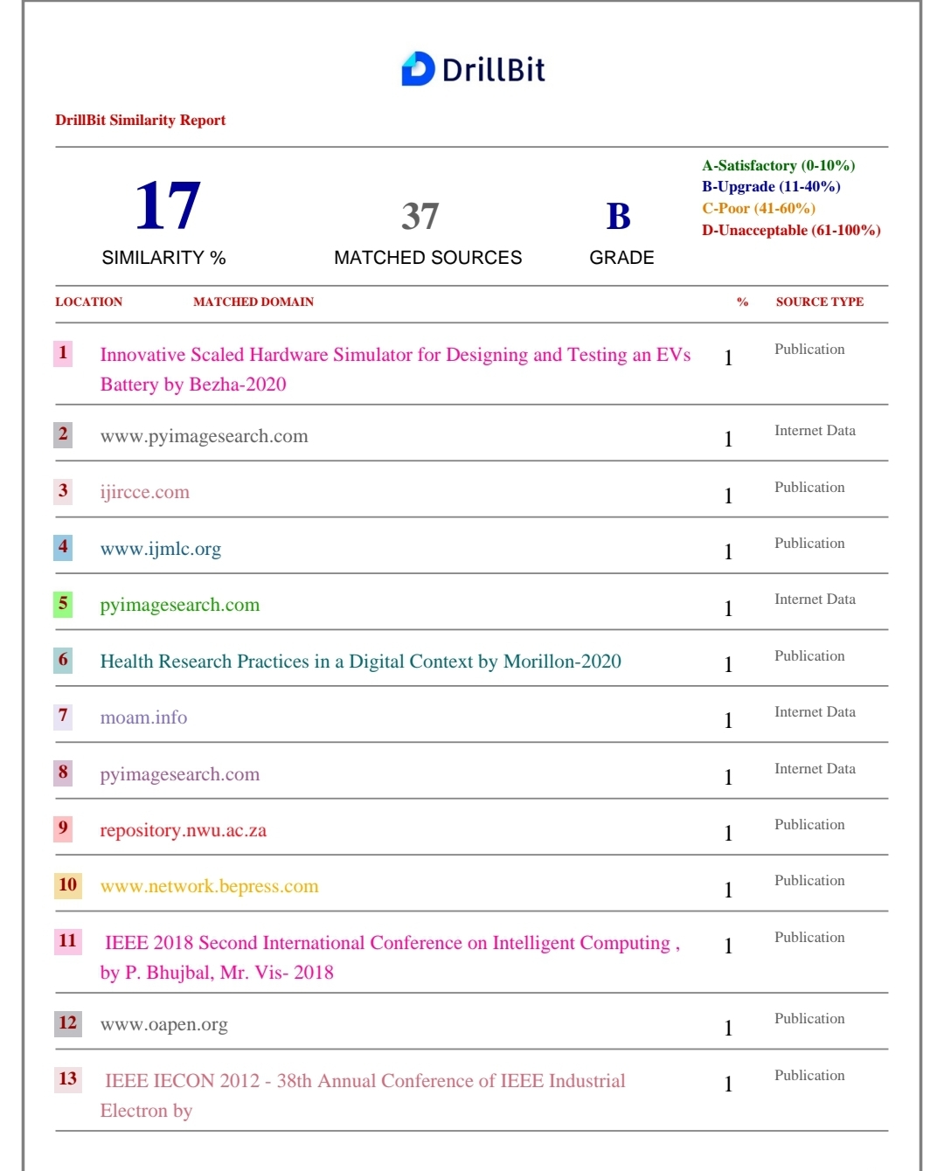
Plagiarism

Slide 16
Thank You

